Slide 1
Sledge Meeting 10/27/2021

Slide 2
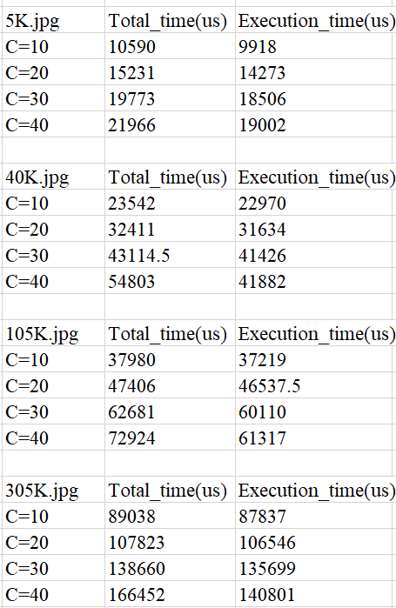
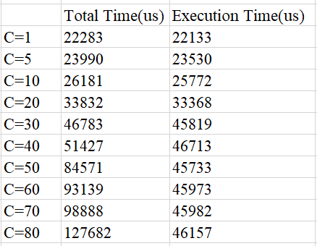
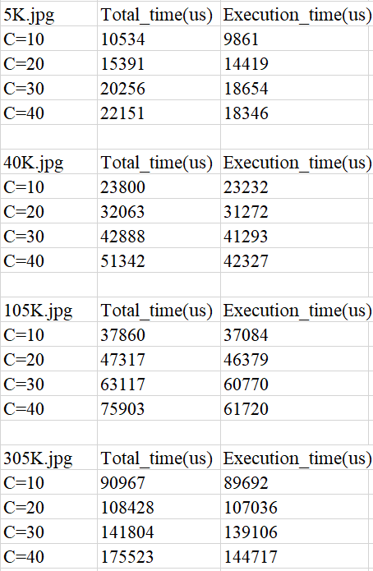
Single Request - Single Function (img Resize)
Single Request - Chain Function
EDF
SRSF

Slide 3
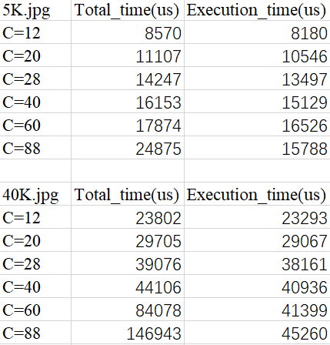
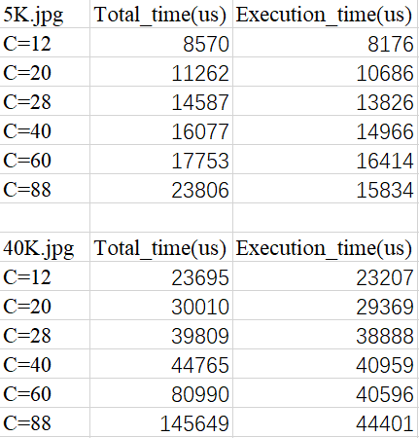
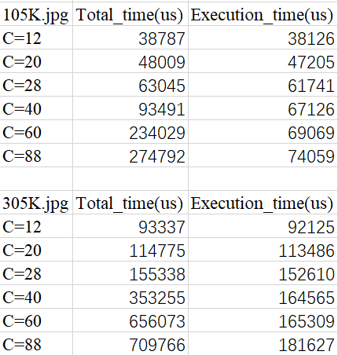
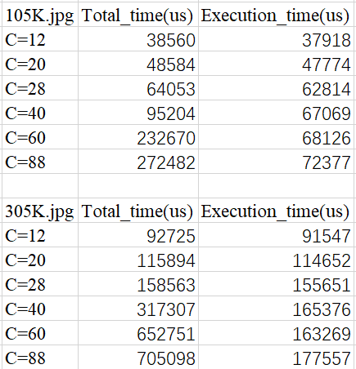
Mixed type of Requests(30 cpu cores)
EDF
SRSF

Slide 4
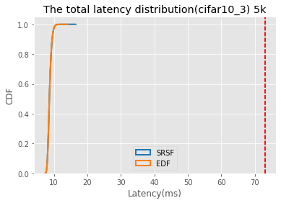
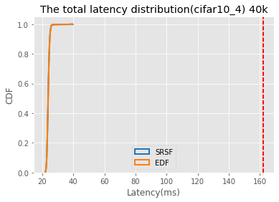
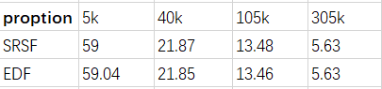

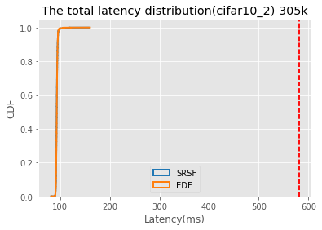
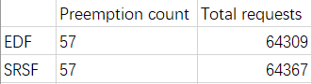
EDF vs SRSF(C=12)
For the light workload, the requests distribution are the same, all requests meet their deadline
SRSF:
cifar10_3 :max latency is:16662 us
cifar10_4: max latency is:39746 us
cifar10_1 : max latency is:68361 us
cifar10_2 : max latency is:159235 us
EDF:
cifar10_3 max latency is:14436 us
cifar10_4 max latency is:39674 us
cifar10_1 max latency is:70873 us
cifar10_2 max latency is:161617 us

Slide 5
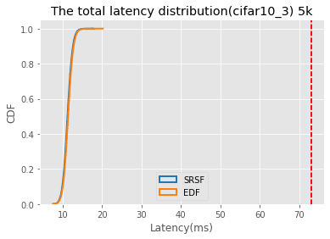
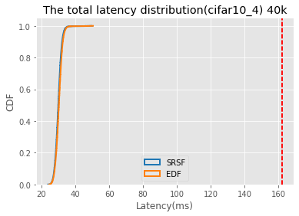
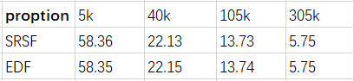
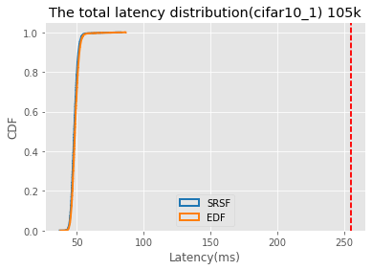
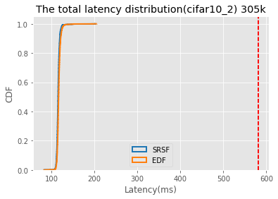
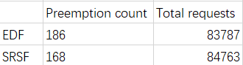
EDF vs SRSF(c=20)
For light workload, all requests meet their deadline, it seems SRSF has a shorter tail latency then EDF, but don’t know if this is randomness

Slide 6
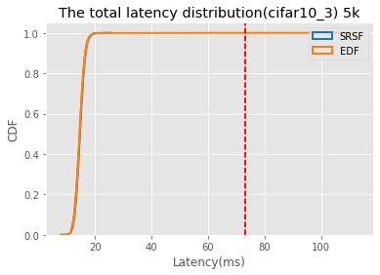
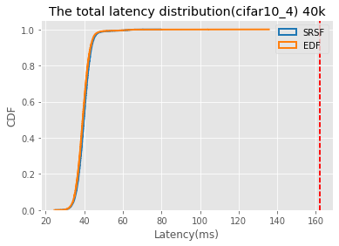
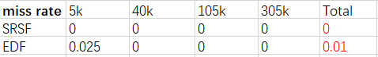
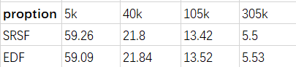
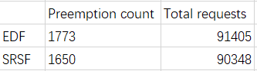
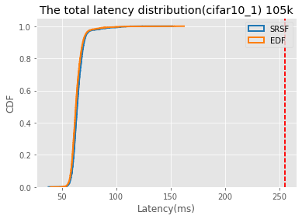
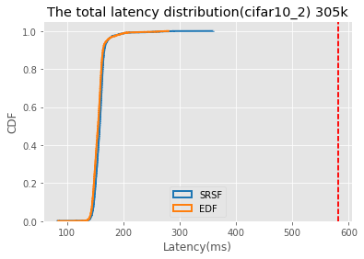
EDF vs SRSF(C=28)
For light workload, SRSF has a shorter tail latency then EDF with 5k, 40k and 105k requests, but longer tail latency than EDF with 305k requests, but don’t know if this is randomness.

Slide 7
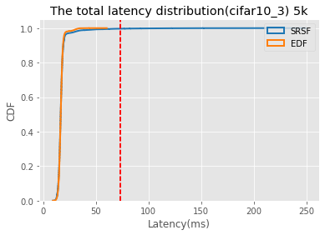
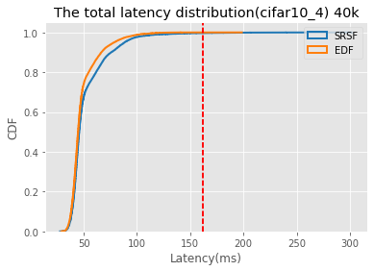
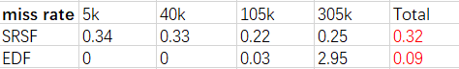
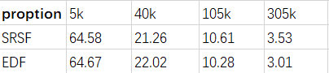
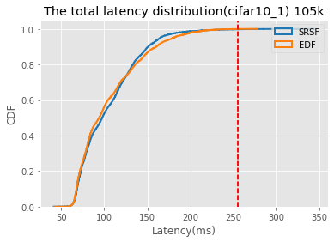
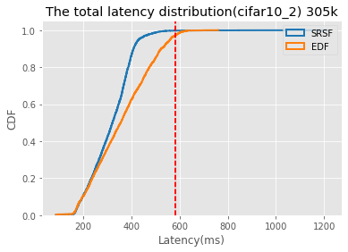
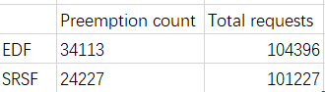
EDF vs SRSF(C=40)

Slide 8
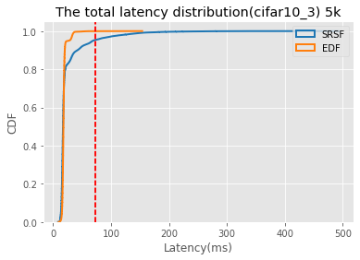
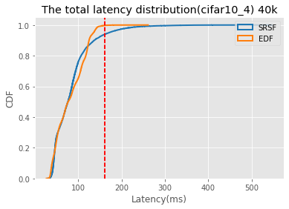
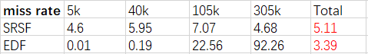
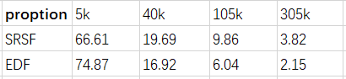
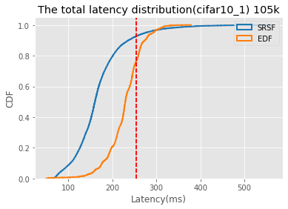
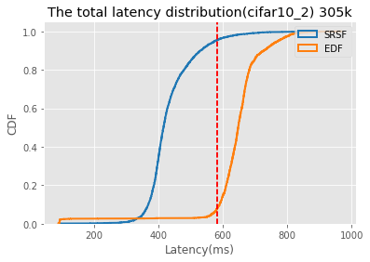
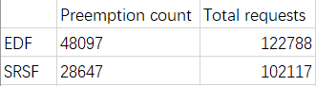
EDF vs SRSF(C=60)

Slide 9
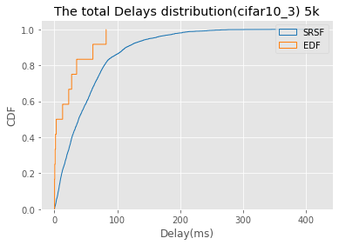
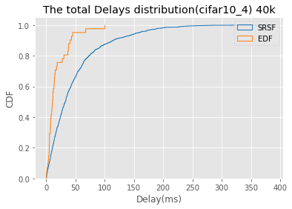
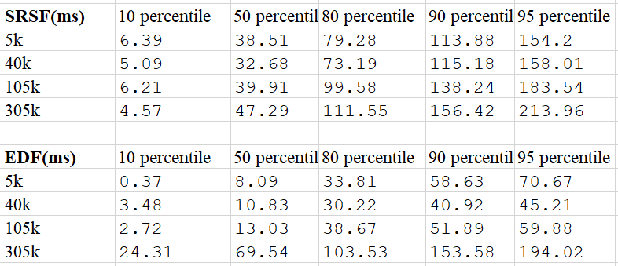
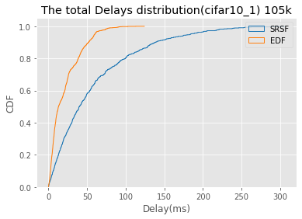
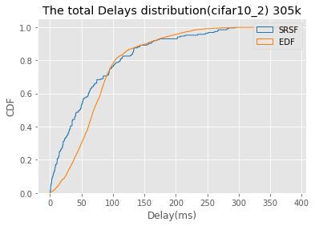
EDF vs SRSF(C=60)
Delays Distribution
SRSF:
function: 5k 99% p delays: 229
function: 40k 99% p delays: 228
function: 105k 99% p delays: 245
function: 305k 99% p delays: 281
EDF:
function: 5k 99% p delays: 79
function: 40k 99% p delays: 87
function: 105k 99% p delays: 80
function: 305k 99% p delays: 248

Slide 10
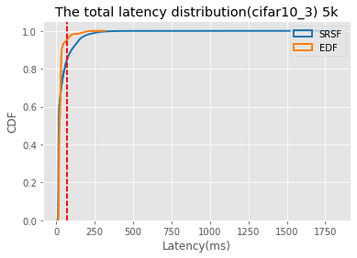
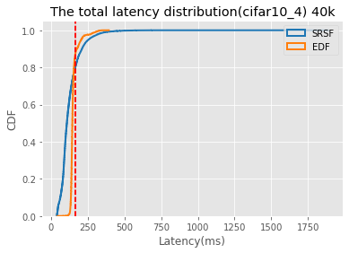
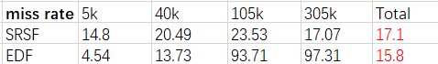
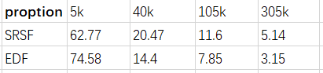
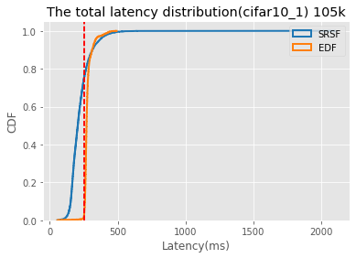
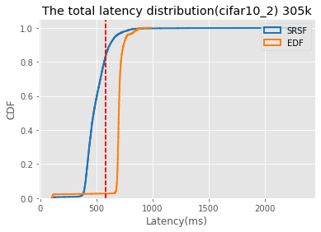

EDF vs SRSF(C=88)

Slide 11





EDF vs SRSF(C=88)
Lateness Distribution
SRSF:
function: 5k 99% p delays: 294
function: 40k 99% p delays: 335
function: 105k 99% p delays: 287
function: 305k 99% p delays: 1005
EDF:
function: 5k 99% p delays: 150
function: 40k 99% p delays: 170
function: 105k 99% p delays: 170
function: 305k 99% p delays: 286

Slide 12







EDF vs SRSF(C=120)

Slide 13





EDF vs SRSF(C=120)
Delays Distribution
SRSF:
function: 5k 99% p delays: 437
function: 40k 99% p delays: 474
function: 105k 99% p delays: 513
function: 305k 99% p delays: 575
EDF:
function: 5k 99% p delays: 172
function: 40k 99% p delays: 175
function: 105k 99% p delays: 201
function: 305k 99% p delays: 317

Slide 14










EDF vs SRSF(C=152)

Slide 15





EDF vs SRSF(C=152)
Delays Distribution
SRSF:
function: 5k 99% p delays: 587
function: 40k 99% p delays: 613
function: 105k 99% p delays: 650
function: 305k 99% p delays: 799
EDF:
function: 5k 99% p delays: 175
function: 40k 99% p delays: 206
function: 105k 99% p delays: 237
function: 305k 99% p delays: 340

Slide 16




Requests Distribution

Slide 17
Sledge Meeting 11/2/2021

Slide 18

Execution Time With Single Function
System has 32 CPU cores
CPU 0 is “idle” for OS processes, CPU 1 is for Sledge main thread and listening thread.
CPU=28 means start 28 worker threads and let 2 cpu cores “idle”

Slide 19

Execution Time With Single Function
System has 32 CPU cores
CPU 0 is “idle” for OS processes, CPU 1 is for Sledge main thread and listening thread.
CPU=28 means start 28 worker threads and let 2 cpu cores “idle”

Slide 20
Single Function Execution Time(from a decision of running a sandbox has been made to the http response been sent out)
Non-blocking read data from network (if blocked, blocking time will be subtracted from execution time)
Calling two wasm apis (populate_globals and populate_memory)
Execute function code
Non-blocking write data to the client( if blocked, blocking time will be subtracted from execution time)
If preemption happened in 3 (couldn’t be in 1,2,4 because these steps are nonpreemptible), preemption time will be subtracted from execution time)

Slide 21

Execution Time Breakdown(30 Worker threads, concurrency 1 and 40)

Slide 22


Linux Total threads
CPU time slice is expired – threads context switch (might not be the main contribution to the overhead)
System call(mode switch overhead)
More requests will have more system calls (read/write) and more mode switches overhead.(flush cache? More Cache miss)
C1: 4252 , C40: 61222
Direct and indirect overhead:
Direct: Context switch – save registers, TLB, page table for the current thread and restore registers, page table and TLB for the next thread.
Indirect: When context switch, cause cache miss.

Slide 23




C=40 run 60 seconds: Context switch
C=1 run 60 seconds: Context switch

Slide 24


C=40 run 60 seconds:
Page fault
C=1 run 60 seconds:
Page fault

Slide 25


C=40 run 60 seconds:
Cache miss
C=1 run 60 seconds:
Cache miss

Slide 26


C=40
C=1

Slide 27
Sledge Meeting 11/10/2021

Slide 28



Execution Time With Single Function(image resize)

Slide 29




LoadTest: Poisson Distribution

Slide 30
Calculate Sending Rate To Overload or Underload
5k: 18346
40k: 42327
105k:61720
305k:144717
40k: 2.3 times of 5k
105k: 3.3 times of 5k
305k: 7.8 times of 5k
Total capacity for 5k in one cpu core = 1000/18 = 55 rps
Total capacity for 5k in 30 cpu core = 55 rps * 30 = 1666 rps (60%, 65%, 70%, 75%, 80%)
4 loadtest, each one get 1666/4= 416 rps – 53.6%
For 40k, should be 416 rps / 2.3 = 181 rps – 23.3%
For 105k, should be 416 rps / 3.3 = 126 rps – 16.2%
For 305k, should be 416 rps / 7.8 = 53 rps – 6.8%
For 5k – 60% - 527
For 40k - 25% - 220
For 105k - 10% - 88
For 305k– 5% - 44

Slide 31


Result is not stable(Mixed requests) – miss deadline rate
Miss deadline rate
RPS Settings

Slide 32

Result is not stable(single requests) – miss deadline rate
Miss deadline rate

Slide 33
LoadTest
Concurrency 10:
LoadTest will start 10 threads to send requests. If RPS is 120, then each thread RPS = 120 / 10 = 12 RPS.
Each thread will send requests to sledge with RPS 12. To achieving 12 RPS, each thread calculate the time interval for sending request = 1000 / 12 = 83 ms.
For each thread:
The first request is sent at 0 time,
The second request is sent at 0 + 83.
The third request is sent at 83 + 83.
…..
So the total concurrency is 10, rps is 120. The problem is every 83 ms, a burst of 10 requests are sent to sledge, then wait for 83 ms, then another 10 requests are sent to sledge.

Slide 34

Calculate Sending Rate To Overload or Underload
5k: 10019
40k: 27440
105k:46013
305k:116240
40k: 2.7 times of 5k
105k: 4.6 times of 5k
305k: 11.6 times of 5k
Total capacity for 5k in one cpu core = 1000/10 = 100 rps
Total capacity for 5k in 14 cpu core = 100 rps * 14 = 1400 rps (60%, 65%, 70%, 75%, 80%)
For 5k – 60% - 487
For 40k - 25% - 202
For 105k - 10% - 81
For 305k– 5% - 41
Physical CPU core 14

Slide 35


Uniform Distribution With single type of request (5k.jpg)
Running 2 minutes
Running 1 minutes
669428 / 9874 = 67.29 requests
67.69 / 120 = 0.56 request per second
67.29 / 14 = 4.8 second
14request * 120s * 10ms = 168000ms compare to 7359 ms

Slide 36

Possion Distribution With Mixed type of requests

Slide 37


Possion Distribution With Mixed type of requests :srsf

Slide 38


Possion Distribution With Mixed type of requests :edf

Slide 39
50% percentage - Miss deadline rate

Slide 40




60% percentage

Slide 41




61% percentage

Slide 42





62% percentage

Slide 43





63% percentage

Slide 44




64% percentage

Slide 45





65% percentage

Slide 46


SRSF vs EDF with single type of function(5k.jpg)

Slide 47
SRSF vs EDF with single type of function(5k.jpg)
Total Execution Time
Total System CPU Time = 120 * 14 = 1680s
1045/1680 = 62%
1206/1680 = 71.78%
1507/1680 = 89.7%

Slide 48


SRSF vs EDF with single type of function(305.jpg)

Slide 49

SRSF vs EDF with single type of function(305.jpg)
Total Execution Time
Total System CPU Time = 120 * 14 = 1680s

Slide 50

SRSF vs EDF with single type of function

Slide 51
Sledge Meeting 11/29/2021

Slide 52





EDF vs SRSF with 71% of 5k.jpg request
Deadline: 40ms
EDF
SRSF

Slide 53


EDF vs SRSF with 71% of 5k.jpg request
Deadline: 40ms
EDF
SRSF

Slide 54





EDF vs SRSF with 80% of 305k.jpg request
Deadline: 464ms
EDF
SRSF

Slide 55


EDF vs SRSF with 80% of 305k.jpg request
Deadline: 464ms
EDF
SRSF

Slide 56
EDF vs SRSF - Discussion
Single function doesn’t show the behavior, EDF is similar as SRSF
Single Worker Core doesn’t show the behavior, EDF is similar as SRSF
Two problems:
1. Hugepage setting might affect the execution time.
2. Deferred signal alarm might affect the EDF and SRSF
For short request, like 5k.jpg, it’s execution time is 10ms, for each of them, its execution time might be less than 5ms, so once the scheduler schedule some task to run due to the more urgent task was blocked at IO, then it will be done until complete.
For the blocked IO become unblocked, it’s not asynchronous, sledge only retrieve the ready IO when the signal alarm happened.

Slide 57

TODO: 1.To show the requests distribution 2.

Slide 58
Sledge Meeting 12/1/2021

Slide 59

RPS Settings
14 physical CPU cores with 3.3Ghz cpu speed. Faster.
Maximum RPS:
5K = 1000 / 18 * 14 = 779, time interval is 1000/779, around 1ms.
305k = 1000 / 118 * 14 = 119, time interval is 1000/119, around 10ms.

Slide 60


Miss Deadline Rate and Preemption(Single 5k)
Miss deadline rate
Preemption count

Slide 61


Latency and execution time (Single 5k)
Total Latency
Execution Time

Slide 62





Time Series – 84% of maximum RPS – 5K.jpg
EDF
SRSF

Slide 63





Repeat
EDF
SRSF

Slide 64




Disable Preemption with 84% of maximum RPS( 5k)
EDF
SRSF

Slide 65







EDF(99% miss deadline rate)

Slide 66


SRSF
EDF

Slide 67


305k Single type of function (Maximum RPS=119)
Miss deadline rate
Preemption count

Slide 68


305k Single type of function
Total Latency
Execution Time

Slide 69




305K single with 94% of maximum RPS
EDF

Slide 70
Sledge Meeting 12/6/2021

Slide 71




5k with peemption enable and disable

Slide 72




5k with peemption enable and disable

Slide 73
RPS Settings for Mixed type of requests
14 physical CPU cores with 3.3Ghz cpu speed. Faster.
40k: 1.9 times of 5k
105k: 2.9 times of 5k
305k: 6.4 times of 5k
Total capacity for 5k in one cpu core = 1000/18 = 55.5 rps
Total capacity for 5k in 14 cpu core = 55.5 rps * 14 = 778 rps
For 5k – 60% - 277 , deadline settings, 2x,3x,4x
For 40k - 25% - 115, deadline settings
For 105k - 10% - 46, deadline settings,
For 305k– 5% - 23, deadline settings

Slide 74


Mixed Requests with 3 deadline settings

Slide 75












Mixed Requests with 3 deadline settings

Slide 76


Single 5k with 3 deadline settings
Broadcast vs Triaged/Selective
Gray vs Red

Slide 77






Single 5k with 3 deadline settings
EDF+disable preemption
EDF
SRSF

Slide 78


Single 5k with 3 deadline settings
Triaged propagation: SRSF VS EDF
Triaged propagation VS broadcast

Slide 79


Single 5k with 3 deadline settings
Full data
Cut down data
EDF

Slide 80


Single 5k with 3 deadline settings
Full data
Cut down data
SRSF

Slide 81


Single 5k with 3 deadline settings
Full data
Cut down data
EDF-disable preemption

Slide 82



Single 305k with 3 deadline settings

Slide 83



Single 305k with 3 deadline settings
EDF
SRSF
EDF-disable preemption

Slide 84




Single 305k with 3 deadline settings

Slide 85
12/16/2021 Sledge Meeting

Slide 86


Single requests(5k.jpg) with 3 deadline settings
The miss-deadline-rate of EDF and SRSF with short requests is very close:
When underloaded, all algorithms can meet deadline.
When overloaded, different algorithms have little different miss-deadline-rate (SRSF is slightly better than EDF).
When overloaded, the total latency will increase infinitely as the system runs

Slide 87






Latency Distribution with 80% and 90% of the maximum workload
Miss rate:35% vs 30%
80%
90%
Miss rate:97% vs 99%

Slide 88




SRSF performance of using different percentile execution time as the estimated execution time

Slide 89




Single requests(305k.jpg) with 3 deadline settings
When underloaded, all algorithms can meet deadlines
When overloaded, EDF is better than SRSF, but the gap becomes small with workload increasing, for example:
Graph 1, the workload of EDF with miss-deadline-rate 10% is 92.5%; SRSF is 88%, the workload gap is 4.5%.
No one will push the system to so much overloaded rather than scaling up the servers.

Slide 90






Preemption adds overhead for the short requests (5k.jpg) traiged-> triaged

Slide 91






Preemption doesn’t affect the performance of the long requests(305k.jpg)

Slide 92

RPS Settings for Mixed type of requests
14 physical CPU cores with 2.4Ghz cpu speed.
40k: 2.7 tims of 5k
105k: 4.57 tims of 5k
305k: 11.55 times of 5k
Total capacity for 5k in one cpu core = 1000/11.8 = 84.74 rps
Total capacity for 5k in 14 cpu core = 84.74 rps * 14 = 1186 rps
For 5k – 60% - 308 , deadline settings, 2x,3x,4x
For 40k - 25% - 128, deadline settings
For 105k - 10% - 51, deadline settings,
For 305k– 5% - 26, deadline settings
Current machines
Previous machines

Slide 93




Repeat test: Single requests(305k.jpg) with 3 deadline settings

Slide 94


Queue length with 80% workload

